Slide 1
SWEDEn - Wolf monitoring and management
Dr Daniel Ligné
National Game Manager of Sweden

Slide 2
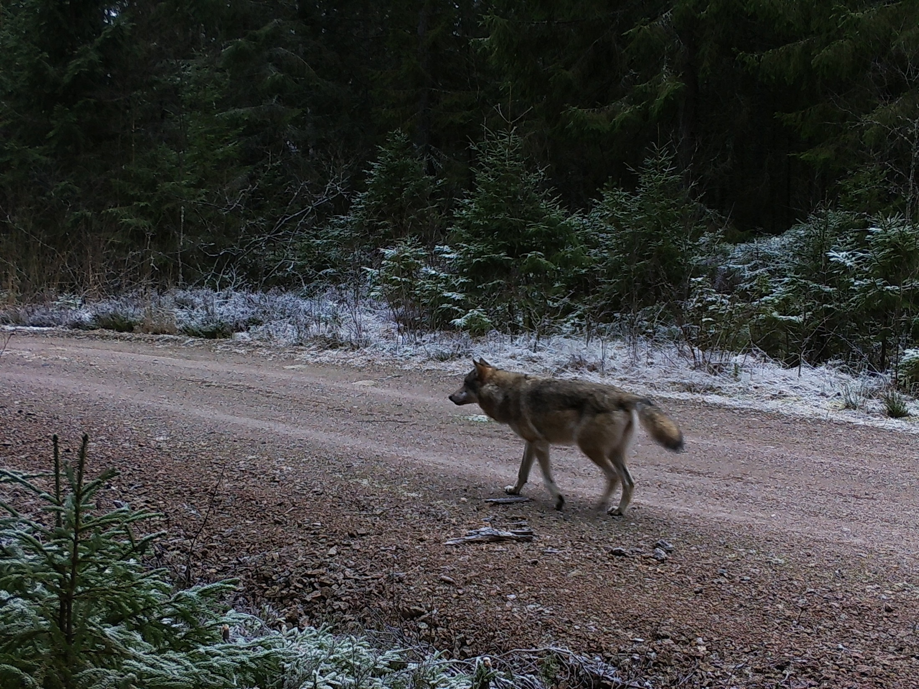
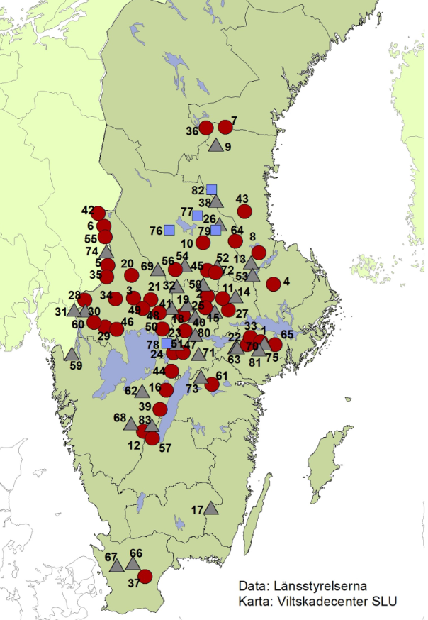
Groups of wolves
2022-2023
= Packs
= 32 Pairs
450 wolves
Foto: Gunnar Glöersen

Slide 3
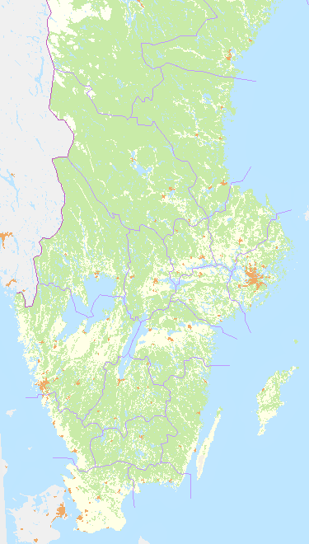
2013

Slide 4
2016

Slide 5
2019

Slide 6
2022

Slide 7
Revirstorlek
Mariano Rodríguez-Recio ,*, Camilla Wikenros , Barbara Zimmermann and Håkan Sand

Slide 8
Mortality
30 % traffic
35% legal hunting
35% probablly illegal hunting
Wolves that leave the pack (around 1 year old) has more than 60% mortality

Slide 9
Biggest effect om moose management

Slide 10
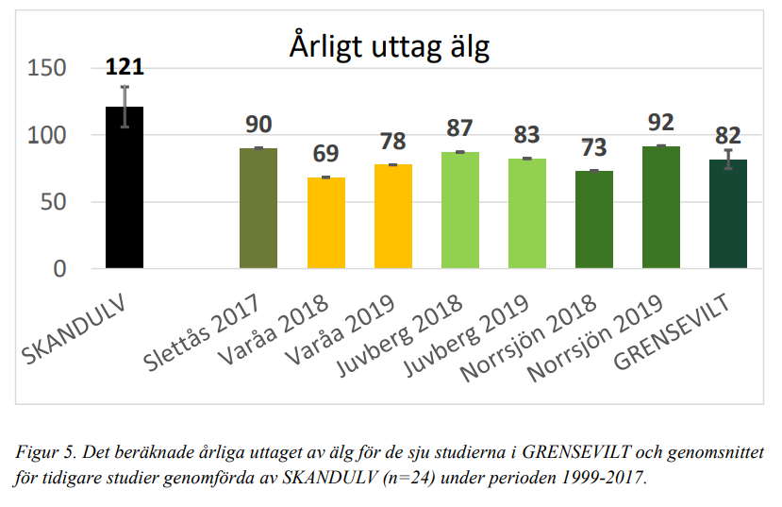
RUBRIK
Harum reptatem. Ut minctur sime et lia porumenis ut eossed ut ar ci dus acerrum aut et liquatum que et et abo. Sed ullabor ibusan tio. Hillorro vid modit offictium eic ta volupta volo ren dusdae plibeat ibusame restisque consequodi consed.

Slide 11
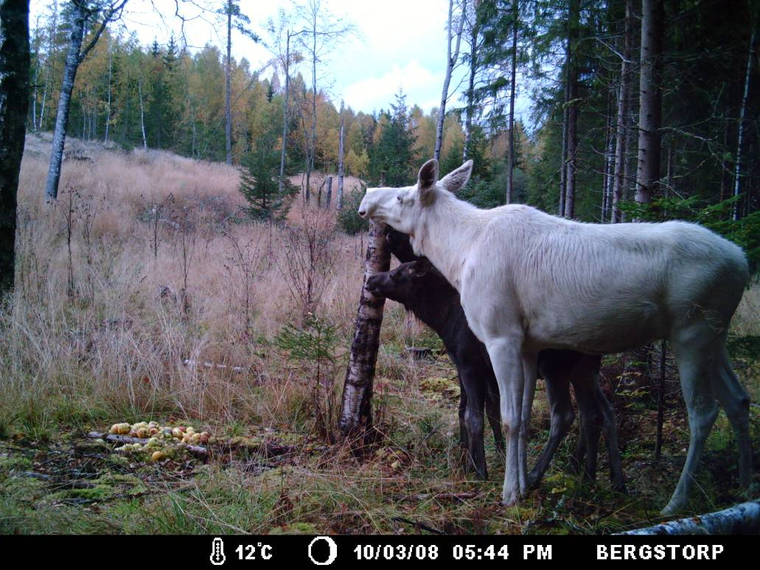
The cows are very important!
Keep tve calves as a ”life insurence” for the cow

Slide 12
Vilken är äldst?
Vilken är äldst?
30 minuter äldre!

Slide 13
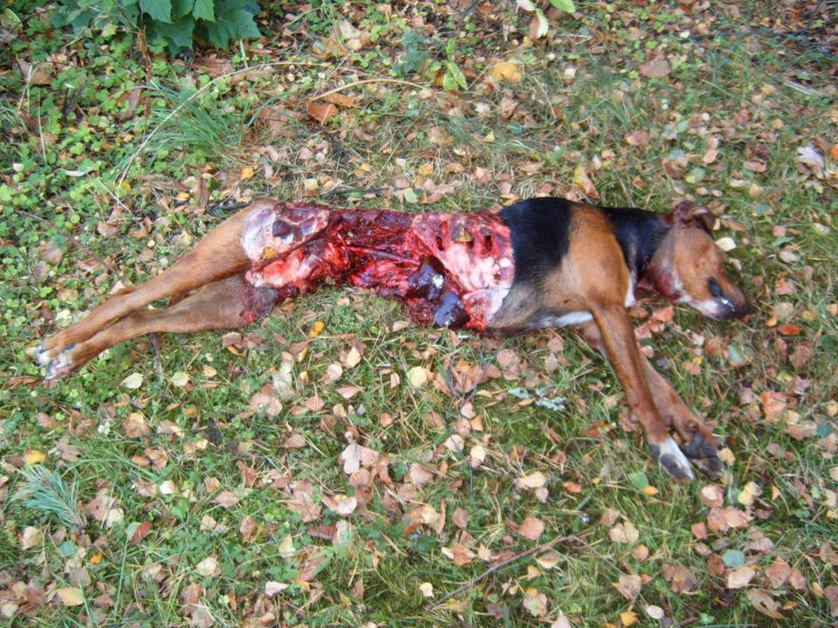
Wolves kill dogs
§ 2 JF – nowadays you or other participants in the hunt can protect the dig if it´s attacked
Foto: Gunnar Glöersen

Slide 14
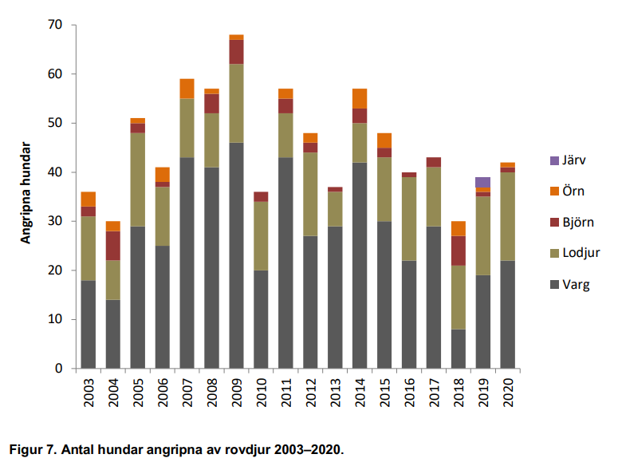
Dog attacks over the years
Källa: Viltskadecenter

Slide 15
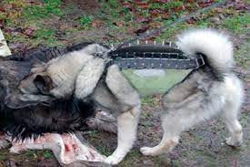
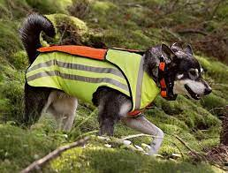
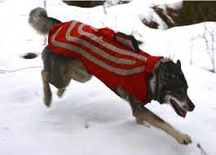
Safety vest

Slide 16
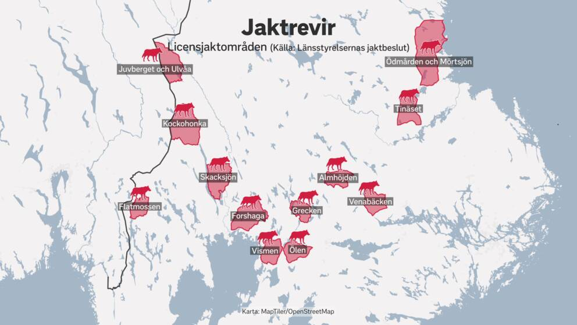
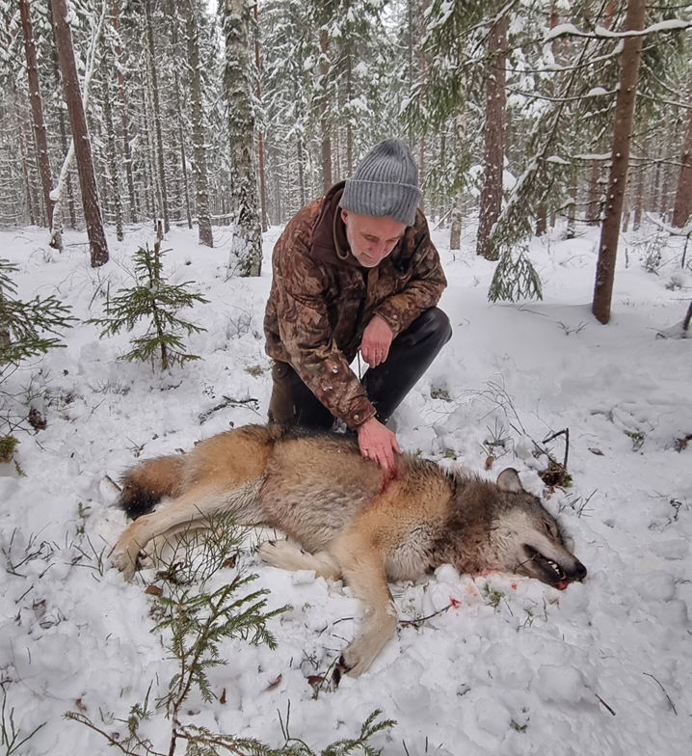
6/0 (5)
10/3
8/2
6/6
Tilldelning/Fällda
Sverige 75/57
6/4
6/6
6/6
6/2
6/6
6/6
6/3
6/6
Karta från SVT

