Slide 1
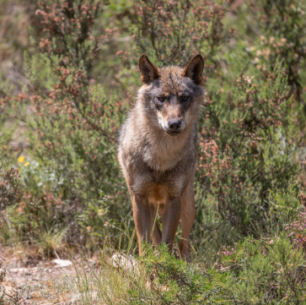
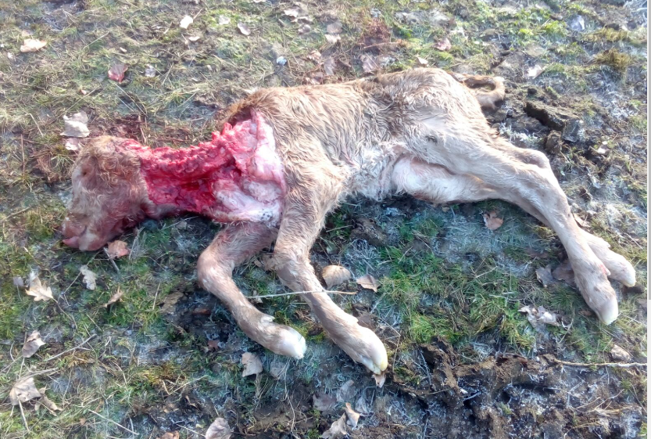
THE STATUS OF THE IBERIAN WOLF (Canis lupus signatus) IN SPAIN

Slide 2
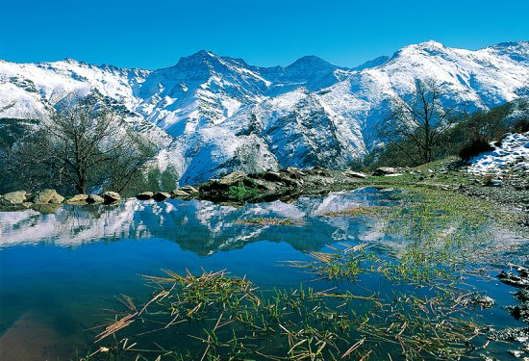
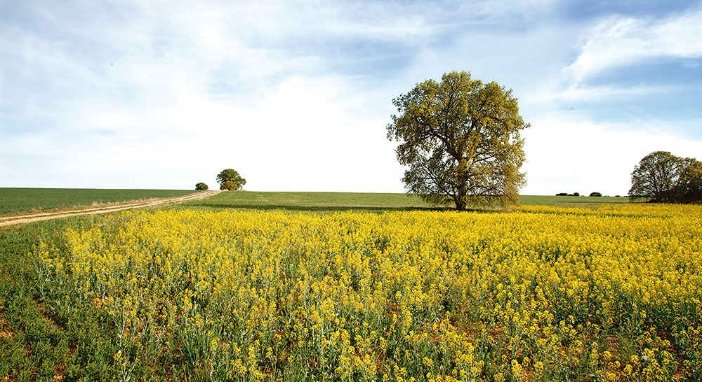
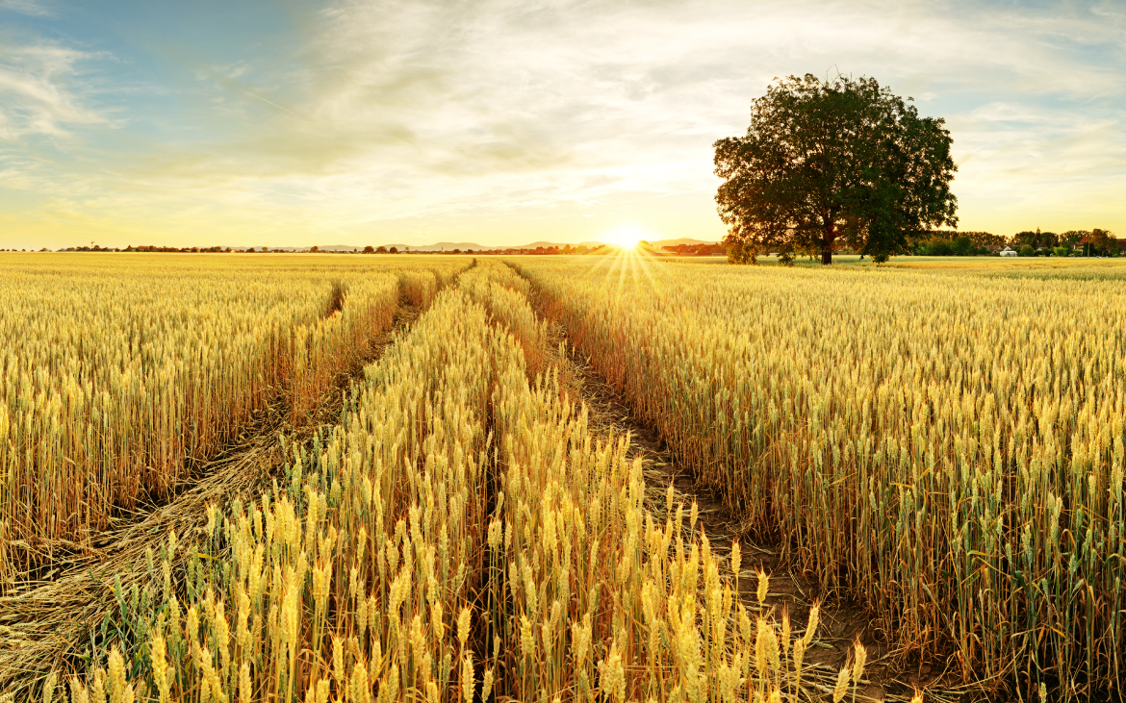
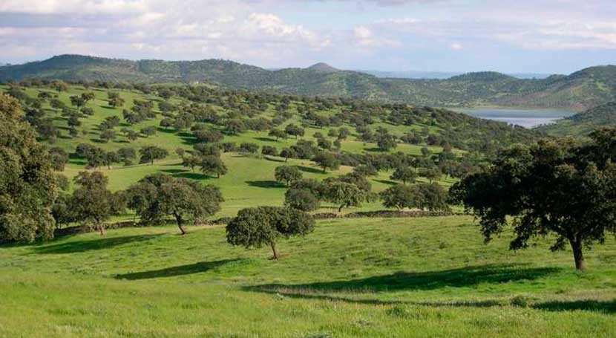
SPAIN, A COUNTRY OF HETOGENEOUS LANDSCAPES
Conflicts in areas where the wolf disappeared almost a hundred years ago.
Production models incompatible with the wolf (Iberian pigs, extensive mountain livestock farming, etc.).
Lack of natural prey in many areas of new expansion leading to an increase in livestock attacks.
Total protection of the species, allowing the control option only as an exception with many limitations.

Slide 3
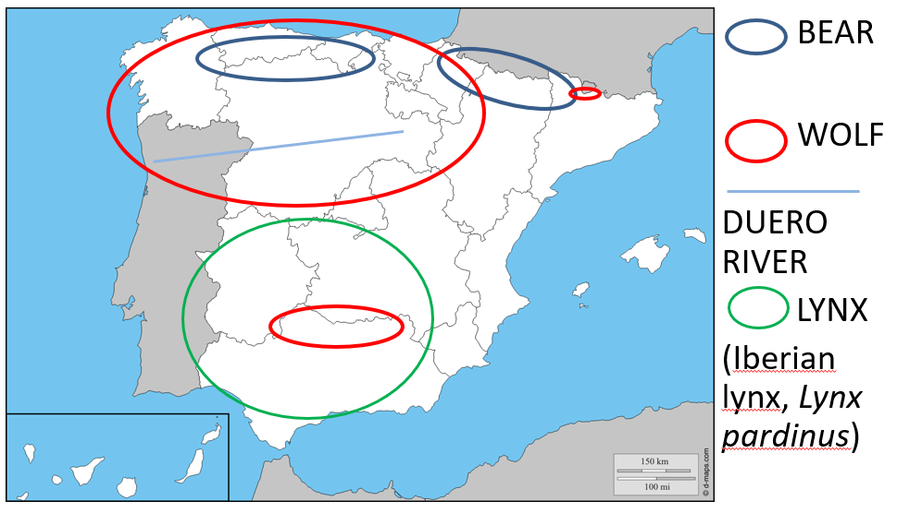
HISTORICAL PERSPECTIVE ON LARGE CARNIVORES IN SPAIN
Growing population of Cantabrian brown bear (Ursus arctos pyrenaicus) facing territorial constraints and increasing conflicts with locals.
Expanding population of Iberian lynx (Lynx pardinus) with reintroduction efforts, involving the work of hunters in the recovery of the Iberian wild rabbit (Oryctolagus cuniculus sp).
Growing and expanding population of Iberian wolf (Canis lupus signatus) in new areas, leading to additional challenges.

Slide 4
HISTORICAL PERSPECTIVE ON LARGE CARNIVORES IN SPAIN
EUROPEAN BROWN BEAR (Ursus arctos pyrenaicus)
STABLE GROWING POPULATIONS
About 400 ind. In two Subpopulations
Cantabrian Subpopulations (Western 280/Oriental >50)
Pyrenean Subpopulations (Western 5/ Oriental > 45)
IBERIAN WOLF (Canis lupus signatus)
Between 2.300 and 3.250 ind. In two Subpopulations
Principal populations (North and South of Duero river, but in the North half) 2.250/3.200 ind.
STABLE GROWING POPULATION
Sierra Morena Subpopulation +- 50 ind. → Extinct
Pyrenean (isolated individuals)
LYNX (Iberian lynx, Lynx pardinus) > 800 ind.
GROWING POPULATION

Slide 5
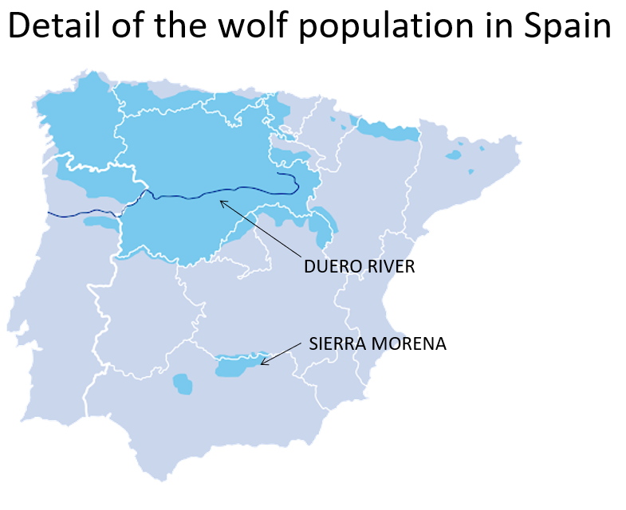
THE IBERIAN WOLF (Canis lupus signatus) IN SPAIN
Wolf in Spain until 2004 → last conservation strategy.
Population in Sierra Morena (southern Iberian Peninsula) with strict protection model and recovery forecast → as a result, EXTINCT in the censuses of 2012-2014
Until 2021, a game species north of the Duero River"

Slide 6
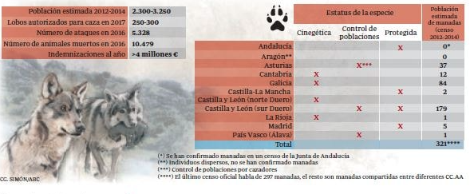
Inclusion of the Iberian Wolf in the List of Wild Species under Special Protection Regime (LESRPE)
In September 2021, the species was added to the protection list, thus prohibiting the possibility of hunting it north of the Douro River.
The decision was taken without updated data, as the last censuses were from 2012-2014.
The RFEC demands that the species be managed based on updated data
Increasing the conflict with the wolf in south of the Duero River

Slide 7
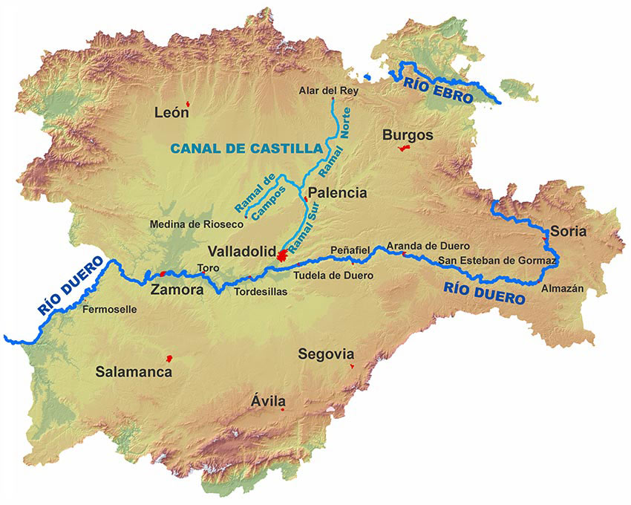
THE CASE OF CASTILLA Y LEÓN. Region with the largest population and the highest number of attacks according to the division of the Duero River"
"Castilla y León was the only region that managed wolf populations with a more flexible model to the north (huntable species) and a stricter model to the south (strictly protected species) until 2021. The data is as follows:
North of the Duero River (slightly over 80% of the population) in 2019, 450 reported attacks (huntable).
South of the Duero River (just under 20% of the population) in 2019, 2,130 reported attacks (non-huntable).
In other words, 80% of the wolf population caused 17% of the damages (where hunting was allowed), while 20% caused 83% of the damages (where hunting was not allowed). This same model has been implemented in the north of the Duero River since 2021."

Slide 8
Wolf Population data in Spain today.
The fact is that, nowadays, there is still no national census of the species in Spain
Each Spanish region does its own census of the species and they send the data to the Spanish Minister of Agriculture and Environment.

Slide 9
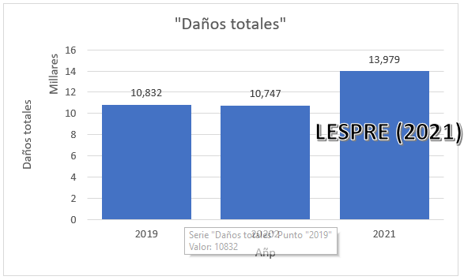
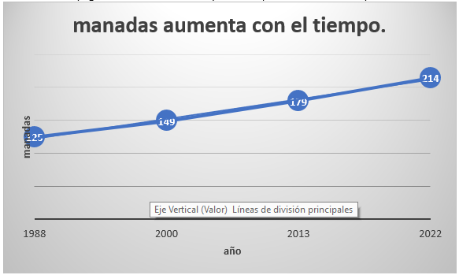
Current wolf data in Spain Total damage Number of herds increases over time

Slide 10
Current wolf data in Spain
THE RFEC HAS SENT THE LATEST DATA TO THE EUROPEAN COMMISSION, TAKING ADVANTAGE OF THE OPPORTUNITY TO ASSESS THE STATUS OF THE WOLF IN EUROPE, DUE TO THE INACTION OF THE MINISTRY.
26% POPULATION INCREASE
FORECAST OF OVER 370 HERDS
MORE THAN 8,000 ATTACK REPORTS AND OVER 10,000 CATTLE HEADS AFFECTED EACH YEAR
€3.5 MILLION SPEND ANNUALLY IN COMPENSATION AND OVER €4 MILLION IN ATTACK PREVENTION
GROWING IMPACT ON WILDLIFE
THE HUNTING MANAGEMENT OF THE SPECIES IS A NECESSITY BACKED UP BY THE FIGURES

Slide 11
Thank you very much

