Slide 1
People and politics

Slide 2
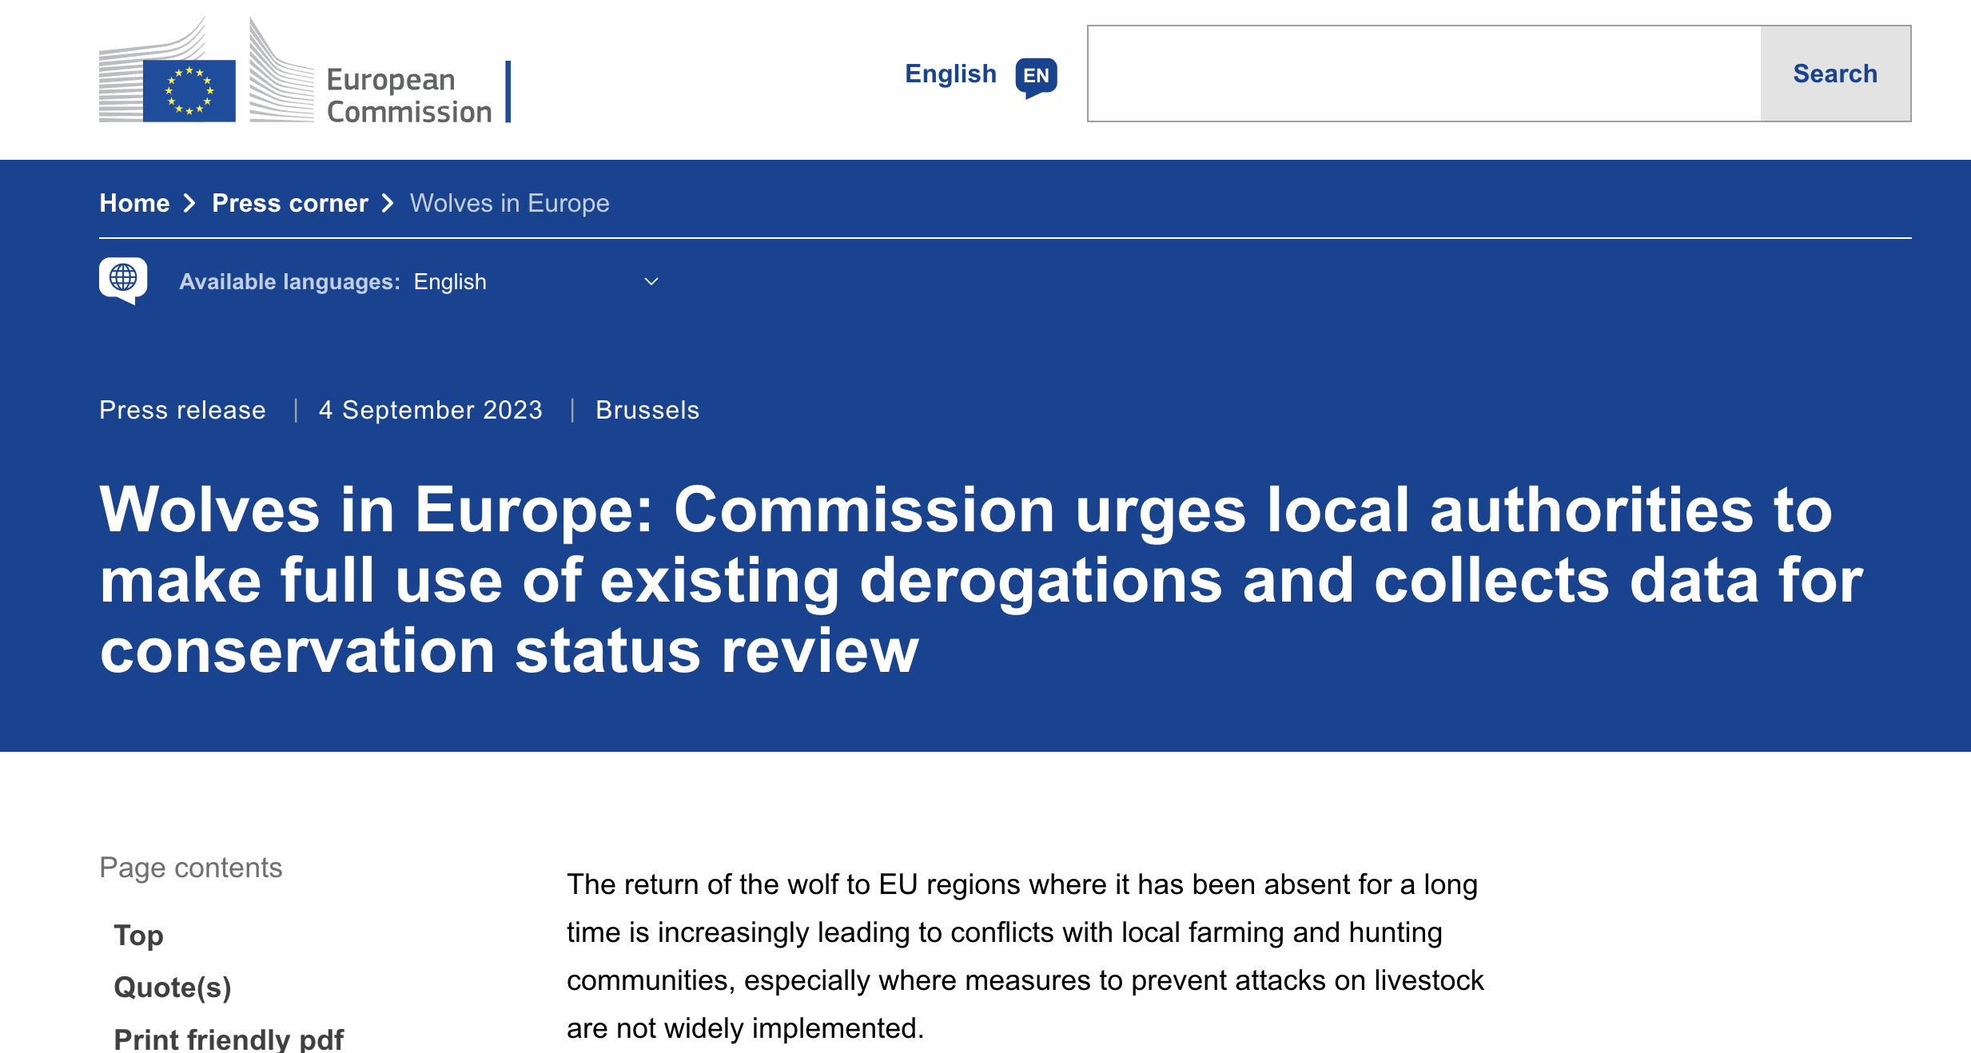

Slide 3
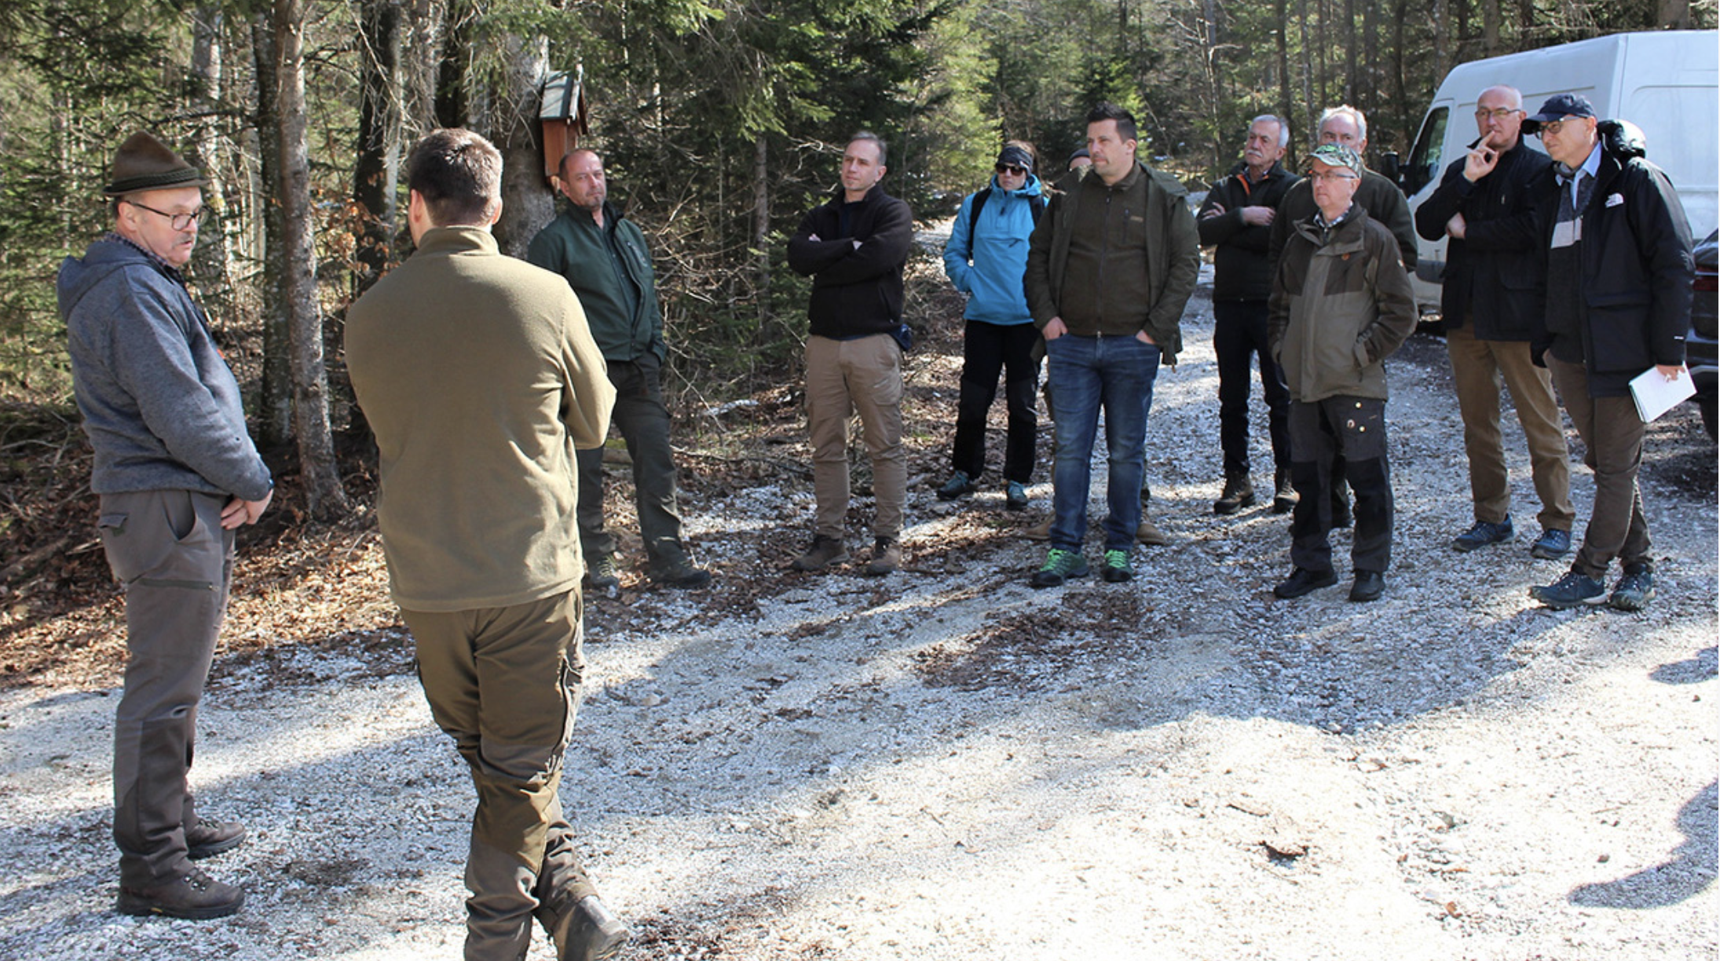

Slide 5
Assessment of conservation status: This should include science-based population-level assessments of wolves that more appropriately recognise their biology and ecology. This would result in more realistic assessments that reflect the increase in population size and range of wolves.

Slide 6
Annexes: A procedure to amend the annexes of the Habitats Directives for large carnivores (where FCS has been reached) should be created.

Slide 7
Footage from Finland
European Hunters’ Conference
Large Carnivores: Delivering FACE’s Strategic Goals for 2027

Slide 8
Communication on flexibility: While the European Commission has stated on several occasions that Member States should use the flexibility in the Habitats Directive, the revision of the Guidance document on strict protection of animal species of Community interest under the Habitats Directive was more restrictive in its interpretation of EU case law than in the previous version.

Slide 9
Coexistence: The EU Platform on Coexistence between People and Large Carnivores is well structured and includes a balanced range of members. It has made good progress in terms of identifying financial instruments and measures for livestock protection, but has struggled to effectively address conflicts related to large carnivore conservation and management. The current rise in conflicts with wolves at Member State level shows no sign of improving. FACE hopes that the current reflection on wolf management within the European Commission will lead to a more balanced state of coexistence.

Slide 10
Conclusion

